Slide 1
COMP532 Tutorial 8
Slides by Botond Hamori

Slide 2
Plan for Today
Topics:
Brief overview of swarm intelligence
Couple of examples
Intro to one of the algorithms
Code Demo
Travelling Salesman
Visualised solution

Slide 3
Swarm Intelligence (SI)
It can be described as:
The global behaviour of a distributed system that arises from the self-organised local interactions between its constituent agents
Multi-agent system
There is no direct communication via interaction with the environment
This is known as “stigmergy”
Allows distributed problem solving
All SI problems are metaheuristic
Group of potential solutions that evolve over time
Stochastic
Exploration vs exploitation
Best solution is not guaranteed, only approximated
Notes:
Stochastic – rely on randomness rather than determinism

Slide 4
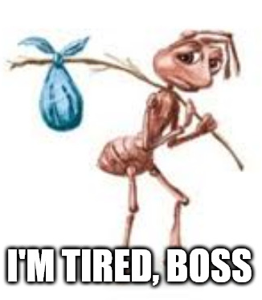
Examples of SI
Ant Colony (ACO) – today
Uses “pheromone trails” and probabilistic path selection

Slide 5
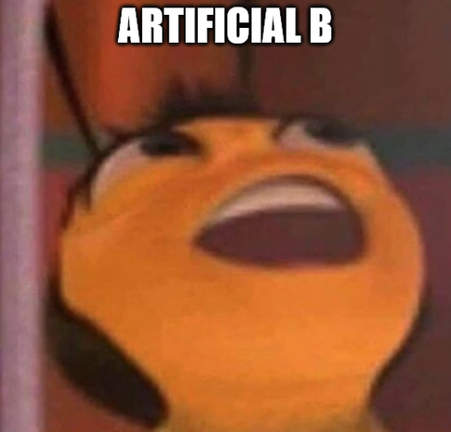
Examples of SI
Ant Colony (ACO) – today
Uses “pheromone trails” and probabilistic path selection
Artificial Bee Colony (ABC) – next week
Probabilistic recruitment strategies to explore/exploit search space

Slide 6

Examples of SI
Ant Colony (ACO) – today
Uses “pheromone trails” and probabilistic path selection
Artificial Bee Colony (ABC) – next week
Probabilistic recruitment strategies to explore/exploit search space
Particle Swarm (PSO) – hopefully next week
Velocity and position updates (with randomness)

Slide 7

Examples of SI
Ant Colony (ACO) – today
Uses “pheromone trails” and probabilistic path selection
Artificial Bee Colony (ABC) – next week
Probabilistic recruitment strategies to explore/exploit search space
Particle Swarm (PSO) – hopefully next week
Velocity and position updates (with randomness)
Grey Wolf – beyond the scope of the module*
Hierarchy between agents
* I just wanted to include the meme…
… also, it’s a cool algorithm

Slide 8
Introduction to ACO
Ants deposit pheromones on paths they traverse
Other ants are guided by this trail
In real life, the purpose is to find the shortest path to food
Today, the ACO algorithm will be introduced by explaining the hyperparameters
I’m going to skip the biology

Slide 9
Pheromone Level
Denoted as τ
Represents the intensity of the trail
Paths with higher pheromone levels are more attractive to ants
Pheromone evaporates over time at a set rate to decrease the influence of older paths
This encourages exploration
Effects:
Too high: the algorithm might get stuck at a local optimum
Too low: the search becomes too random (the algorithm won’t rely on what it’s supposed to learn)
Notes:
τ “tau”

Slide 10
Pheromone Evaporation Rate
Denoted as ρ
Pheromone evaporates – some solutions may be “forgotten” and will be rediscovered
Helps avoid getting stuck at local optima
Rate is set between 0 and 1 (1 = highest)
Low ρ allows the exploitation of good paths for longer
High ρ promotes more exploration (solutions/paths are forgotten sooner)
Notes:
ρ “rho”

Slide 11
Pheromone Deposit Rate
The amount of pheromone deposited depends on the quality of the solution
Deposit is made after an ant traversed a path
Two update types: local and global
Local: the ant moves along the path, and it deposits a small amount of pheromone to influence the movement of other ants (in future iterations)
Global: after the entire colony has completed a solution, the best path found in that iteration is given a significant mount of pheromone to make it more attractive to other ants
Notes:
ρ “rho”

Slide 12
Pheromone Influence
Denoted as α (and usually written as ALPHA in-code)
Controls the importance of pheromone information when choosing the next node in the solution path
High α makes ants more likely to follow paths with higher pheromone levels (more exploitation)
Low α discourages ants from following paths with high pheromone levels (more exploration)
Notes:
ρ “rho”

Slide 13
Heuristic Influence
Denoted as β (and usually written as BETA in-code)
Controls the importance of the heuristic information (e.g. distance, cost, etc)
High β gives more importance to heuristic information
Ants rely more on exploration
Low β forces ants to rely more pheromone values
More exploitation
The α and β values are strongly connected – these values are often defined with the type of problem in mind.
Notes:
ρ “rho”

Slide 14
Total Pheromone Deposit
Denoted as Q
A constant that controls the total amount of pheromone deposited by an ant on its path
Higher Q = more pheromone deposited
Notes:
ρ “rho”

Slide 15
Population
Number of ants in the colony
Controls the exploration/exploitation trade-off
Larger population increases the algorithm’s ability to explore the search space more
Smaller population size may converge faster, but there is more risk of ending up with a solution that is of poor quality
Notes:
ρ “rho”

